Slide 1

Warp-level Parallelism
Maxime ESCOURBIAC - ZZ3F3
16 january 2012

Slide 2
- What is GPU Computing? - The need of new type of computing. - GP-GPU vs CPU. - How to improve GPU efficiency? - Limits of GPU methods. - Solutions given by J.Passerat. - ScalaCL - OpenCL : advantages ? - How does ScalaCL work?
Outline

Slide 3
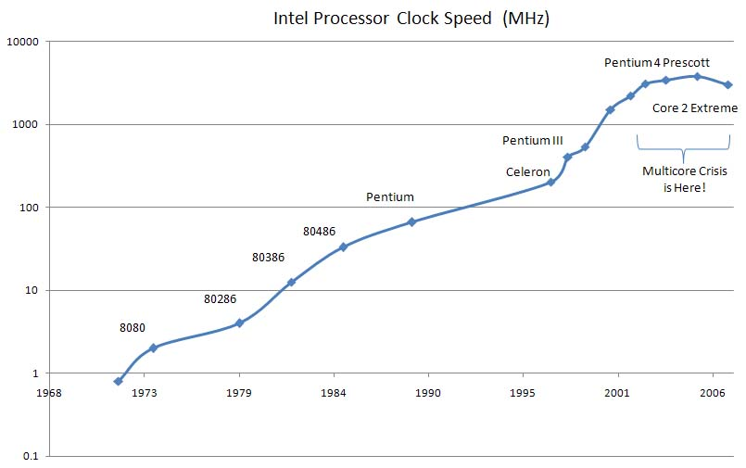
- GPU : Graphics Processing Unit. - Using graphics card to compute. - Limitation of rising of CPU frequency. - Devellopment of multi-core architecture => beginning of parallelism.
What is GPU Computing?

Slide 4
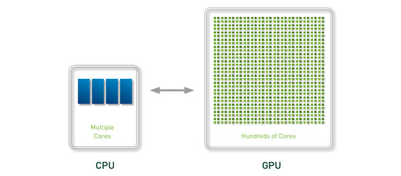
- GPU vs CPU architecture. - Give a new devellopment paradigm. ( Parallel computing ) - Very useful in simulation for replications of experiences. - A cheaper solution ( 500$ for a FERMI Card). - Need to modify of existing models of computation.
What is GPU Computing?

Slide 5
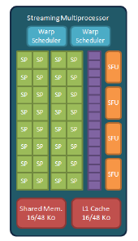
- Performances limited by the architecture. - Each thread need access to memory at the same time. - Asynchronus solutions given by NVIDIA. - Not a deterministic dispatcher.
How to improve GPU efficiency?

Slide 6
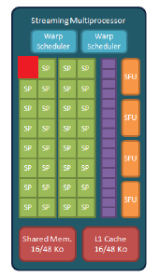
- Warp-Level Paralleslism. - Each Streaming Multiprocessor has 1 thread enabled. - Solve the problem of access memory. - Resource-intensive. ( 1/32 thread effective ).
How to improve GPU efficiency?

Slide 7
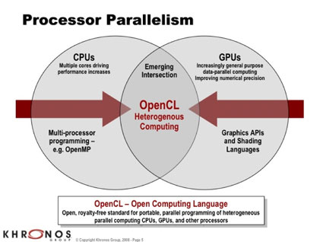
- Multi-platform’s API. - Open and Standard. - Useful in university context. - Computing grid compliant. - Competitor of NVIDIA Cuda.
OpenCL

Slide 8

- Open-source project develloped by Olivier Chaffik. - Run Scala code on GPUs. - High-level language. - ScalaCL Collections. - ScalaCL Compiler plugin.
ScalaCL

Slide 9
- First approach with GPU. - Contributing to an important open-source project. - Learning a new language : SCALA. - Discover Research.
Conclusion

